Slide 1

A MOBILE APPLICATION TO IMPROVE ONLINE LEARNABILITY TO VISUALLY IMPAIRED ELEMENTARY SCHOOL CHILDREN
TMP-23-310

Slide 2
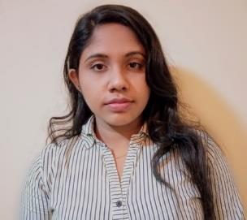
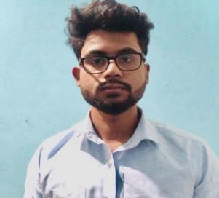
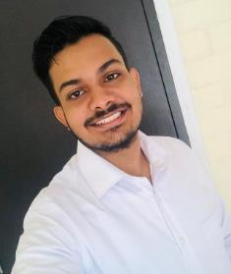
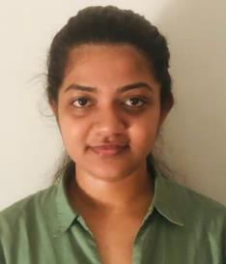
OUR TEAM
Sathsarani B.A.D.A
IT20160098
Dias S.T.D IT20247836
Liyanage A.L.D.K.S.
IT20146474
Nayanananda W.A.K.D
IT20237622

Slide 3

Introduction
The e-learning method is the most prominent way of gaining knowledge and experiences nowadays.
It supports and enhances the learning experience of students whose eyesight is good, it has caused inconvenience for visually impaired students, who find difficulties in online learning.
We are planning to develop a mobile application using the access mode.

Slide 4

Research Question
How to improve online learnability in visually impaired elementary school children?
How to create a platform which facilitates learning in multilingual language?
How visual impaired learners can meet a tutor for learning support?
How to evaluate the effectiveness of the learning activities conducted through the platform?
How to create a platform to recommend a tutor based on learner’s knowledge and level of disability?

Slide 5

Main Objectives
To improve online learnability in visually impaired elementary school children
To create a supportive voice bot which facilitates learning in multilingual language.
To create an e-learning platform for visual impaired learners can meet a tutor for learning support.
To evaluate the effectiveness of the learning activities conducted through the platform.
To create a platform to recommend a tutor based on learner’s knowledge and level of disability.

Slide 6
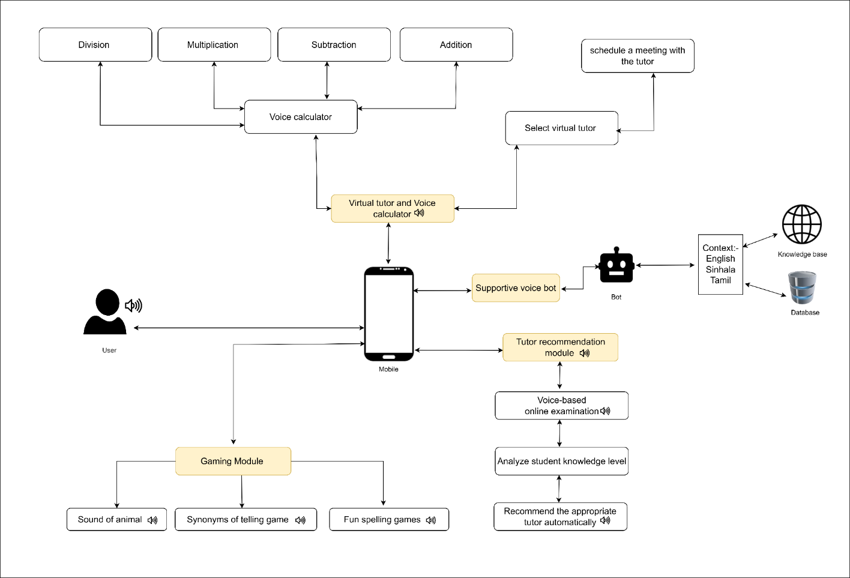
System Overview

Slide 7
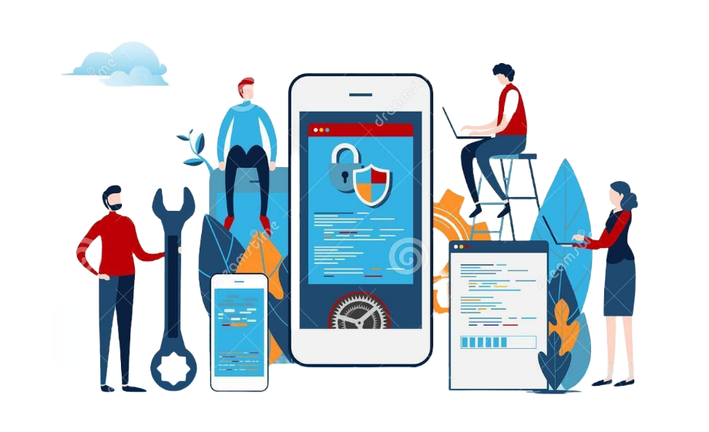
Commercialization
Identifying the target audience: In this case, the target audience would be visually impaired students who could benefit from the features of the mobile application.
We mainly target:
Primary schools that study the visual impaired students
Parents/guardians of the visual impaired primary students
organizations that serve the visually impaired society
Revenue generation: Commercialization also involves generating revenue from the mobile application. This could involve charging for the application itself, offering premium features for a fee, or monetizing through in-app advertising.
Use Social Media to promote

Slide 8
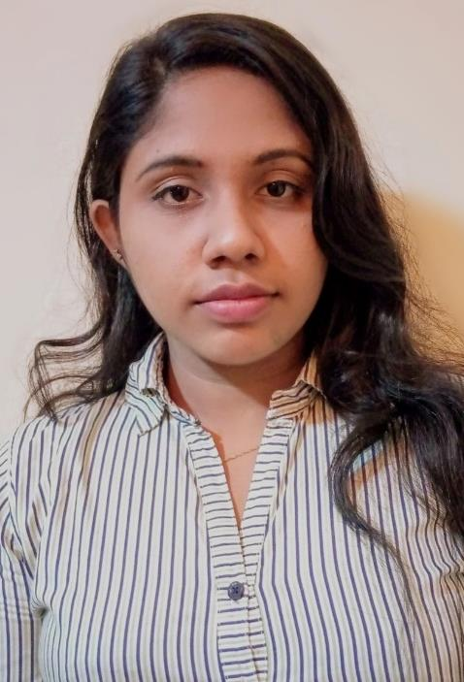
Sathsarani B.A.D.A
IT20160098
Information Technology

Slide 9
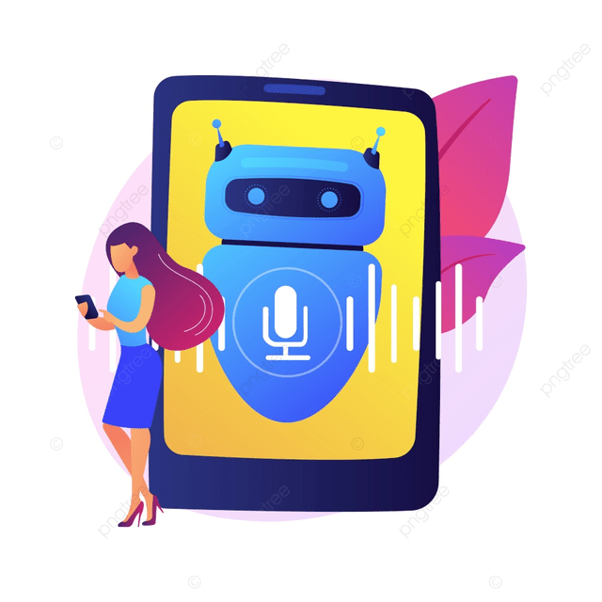
Supportive Voice Bot
Voice bots allow visually impaired students to study independently, without relying on a sighted person to read or interpret information for them.
Voice bots can be used anytime, anywhere, allowing visually impaired students to study and learn on their own schedule and in their preferred environment.
Supportive voice bots can be a valuable tool for visually impaired students to access educational materials and achieve academic success.
IT20160098 | Sathsarani B.A.D.A | TMP-23-310 | Supportive Voice Bot

Slide 10

Research Problem
How to create a platform which facilitates learning in multilingual language?
How to create limited opportunities for independent study for visually impaired students ?
How to create a platform that facilitates the use of accessibility mode?
IT20160098 | Sathsarani B.A.D.A | TMP-23-310 | Supportive Voice Bot

Slide 11

Objectives
To create a supportive voice bot which facilitates learning in multilingual language.
To facilitate the accessibility mode for improving vision in the system.
To providing relevant information and feedback on specific topics.
IT20160098 | Sathsarani B.A.D.A | TMP-23-310 | Supportive Voice Bot

Slide 12


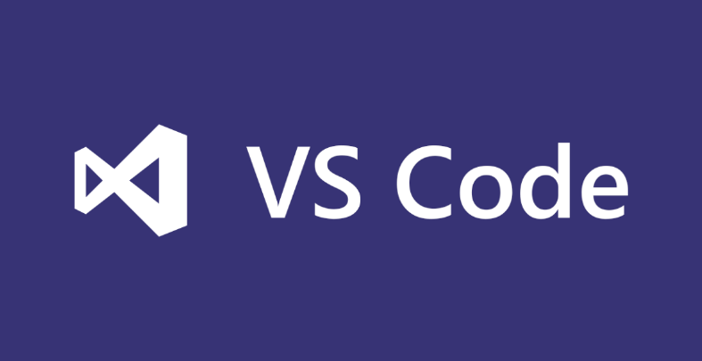
Tools and Technologies
Vs code
Natural Language Processing
React Native
Anaconda navigator
Python
IT20160098 | Sathsarani B.A.D.A | TMP-23-310 | Supportive Voice Bot

Slide 13
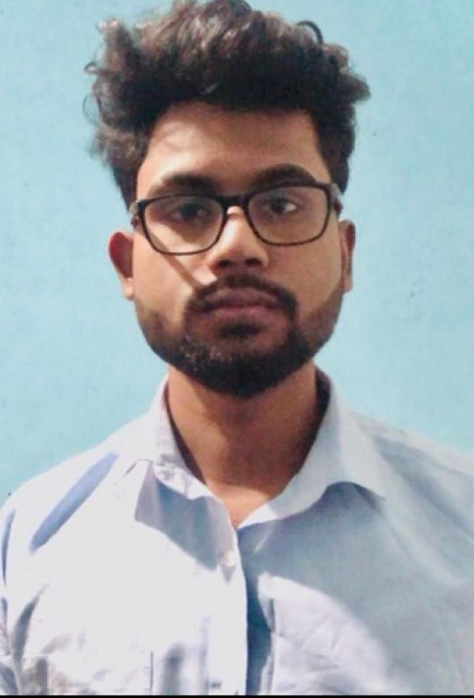
Dias S.T.D
IT20247836
Information Technology

Slide 14
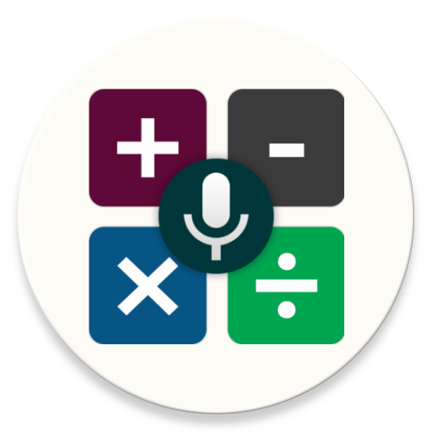
Virtual tutor and Voice based simple calculator
Visually impaired students cannot see the numbers on a traditional calculator or the results of their calculations, which makes it difficult for them to use a regular calculator.
A voice-based calculator uses speech synthesis technology to announce the numbers and results of calculations, allowing visually impaired students to perform mathematical operations independently.
Virtual tutoring sessions can be scheduled at times that are convenient for both the student and the tutor.
Virtual tutoring sessions can help visually impaired students to build their confidence and independence in learning.
IT20247836 | Dias S.T.D| TMP-23-310 | Virtual tutor & Voice based calculator

Slide 15
Research Problem
How visual impaired learners can meet a tutor for learning support?
How to create the simple calculations easier for the visually impaired students ?
How to create a platform that facilitates the use of accessibility mode?
IT20247836 | Dias S.T.D| TMP-23-310 | Virtual tutor & Voice based calculator

Slide 16

Objectives
To create an e-learning platform for visual impaired learners can meet a tutor for learning support.
To make the simple calculations easier for the visually impaired students
To facilitate the accessibility mode for improving vision in the system.
IT20247836 | Dias S.T.D| TMP-23-310 | Virtual tutor & Voice based calculator

Slide 17

Tools and Technologies
Vs code
Mongo Db
React Native
IT20247836 | Dias S.T.D| TMP-23-310 | Virtual tutor & Voice based calculator

Slide 18

Completion of the work for PP2
implement back end of voice base calculator
Create tutor profile UI

Slide 19
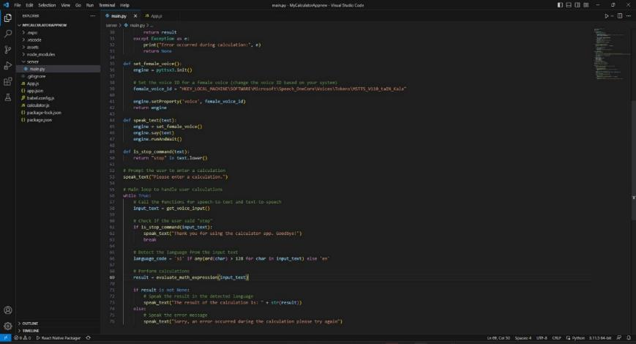
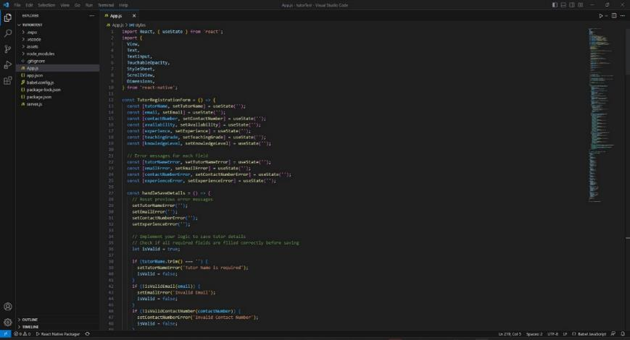

Slide 20
References
IT20247836 | Dias S.T.D| TMP-23-310 | Virtual tutor & Voice based calculator

Slide 21

Liyanage A.L.D.K.S
IT20146474
Information Technology

Slide 22
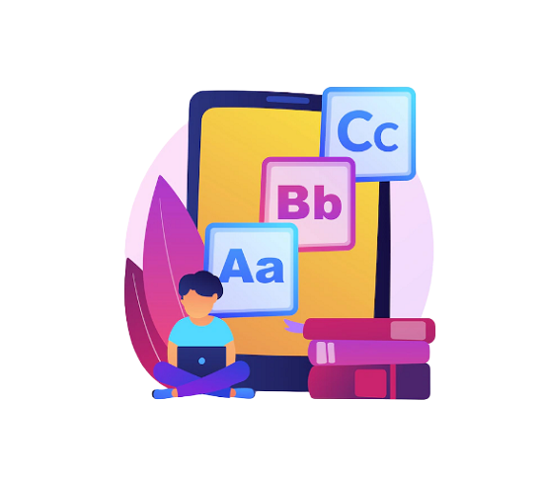
Gaming Module
Brain improvement gaming modules can be designed to be accessible to visually impaired students, providing them with an opportunity to enjoy playing games while also improving their knowledge.
They can help with memory retention and recall: Many visually impaired students rely on auditory and tactile senses to retain and recall information.
Reduced stress and anxiety: Engaging in brain development games can help reduce stress and anxiety levels by providing a fun and challenging way to relax and unwind.
IT20146474 | Liyanage A.L.D.K.S| TMP-23-310 | Gaming Module

Slide 23
Background
“Toward designing mobile games for visually challenged children” [1]
Has developed two audible mobile games were designed and tested.
It is a mobile application
“Mathematics for all: a Game-Based Learning Environment for Visually Impaired Students” [2]
Has developed brain improvement Mathematics mobile application for Visually Impaired Students
A mobile application
"Design and implementation of an educational game considering issues for visually impaired people inclusion"[3]
Here they mainly focused on developing games to make the studies more interesting
They have used various audio-based systems to develop the games
They have used the accessible modules to design the games.
“Design, implementation, and evaluation of a mobile game for blind people: toward making mobile fun accessible to everyone” [4]
It has designed for online games for visually impaired students.
used the audio concept
IT20146474 | Liyanage A.L.D.K.S| TMP-23-310 | Gaming Module

Slide 24
Research Problem
How to evaluate the effectiveness of the learning activities conducted through the platform?
How to create a gaming platform to improve interest in studies while having fun?
How to create a platform that facilitates the use of accessibility mode?
IT20146474 | Liyanage A.L.D.K.S| TMP-23-310 | Gaming Module

Slide 25



Research Gap
Comparison of existing solutions
Research | Brain improvement games | Voice base games | Accessibility mode in the UI design | Mobile application
Research 1 [1]
Research 2 [2]
Research 3 [3]
Research 4 [4]
New Research
IT20146474 | Liyanage A.L.D.K.S| TMP-23-310 | Gaming Module

Slide 26

Objectives
To evaluate the effectiveness of the learning activities conducted through the platform.
To improve interest in studies while having fun.
To facilitate the accessibility mode for improving vision in the system.
IT20146474 | Liyanage A.L.D.K.S| TMP-23-310 | Gaming Module

Slide 27
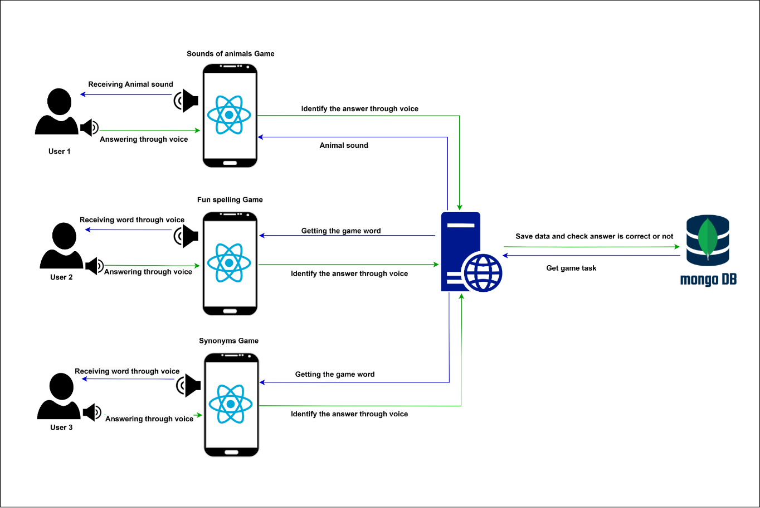
Methodology
IT20146474 | Liyanage A.L.D.K.S| TMP-23-310 | Gaming Module

Slide 28
Tools and Technologies
Vs code
Mongo Db
React Native
IT20146474 | Liyanage A.L.D.K.S| TMP-23-310 | Gaming Module

Slide 29
Requirements
Functional Requirements
Audio and descriptions: The gaming module should provide clear and descriptive audio and descriptions for the visually impaired students to navigate the game, understand their progress, and perform tasks
Voice navigation: The mobile gaming module should have voice navigation, allowing visually impaired students to easily navigate through menus and options.
Clear instructions: The mobile gaming module should provide clear and concise instructions on how to play the game, how to progress through different levels, and how to achieve different objectives
IT20146474 | Liyanage A.L.D.K.S| TMP-23-310 | Gaming Module

Slide 30
Requirements
Non - Functional Requirements
Availability :The application should be able to access and play games at any given time.
Reliability : The Gaming Module output accuracy should be error free, and the code should be bug free.so the translation output could be reliable.
Scalability :The application should be able to handle a large number of users and requests without crashing or experiencing downtime.
Security and privacy : The interface should be protected from attacks.
IT20146474 | Liyanage A.L.D.K.S| TMP-23-310 | Gaming Module

Slide 31
Completion of the work for PP1
Completed the functionalities of Sound of animals, Fun spellings game
Activated the voice for Animal's sound
Activated the voice for Fun spellings
Enabled the screen reader
Enabled the accessibility mode

Slide 32

Completion of the work for PP1
Completed the functionalities of Sound of animals, Fun spellings game
Activated the voice for Animal's sound
Activated the voice for Fun spellings
Enabled the screen reader
Enabled the accessibility mode

Slide 33
Completion of the work for PP2
Completed the functionalities of Sound of animals, Fun spellings game, Synonyms game
Activated the voice for Animal's sound
Activated the voice for Fun spellings
Activated the voice for Synonyms game
Enabled the screen reader
Enabled voice input
Enabled voice instructions (Game instructions)
Enabled gestures (Double tap and Swipe left gestures)
Enabled the accessibility mode

Slide 34
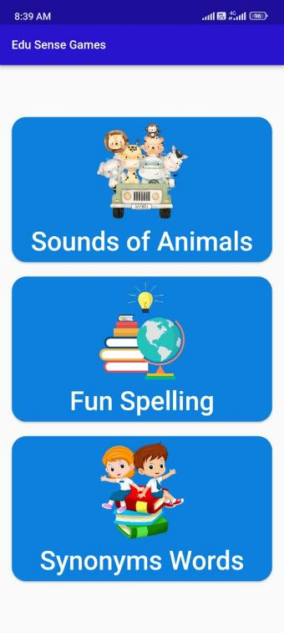
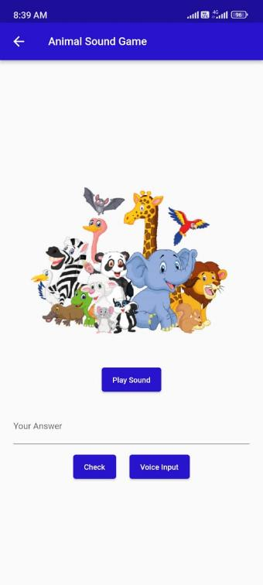
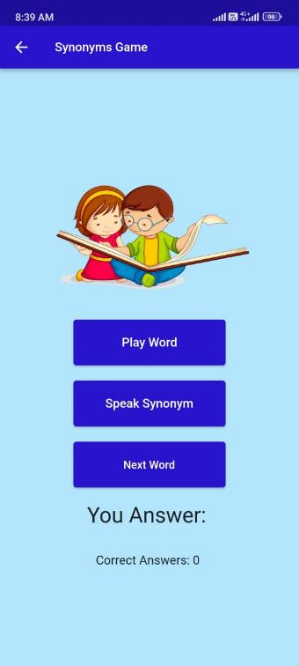
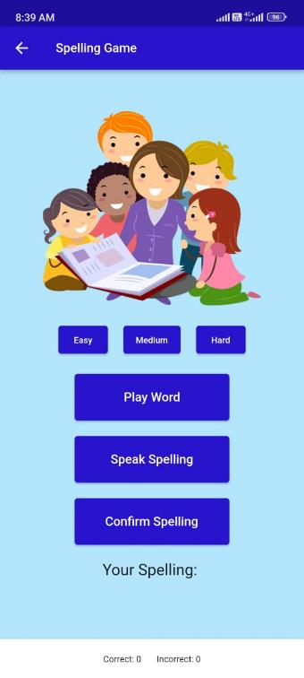

Slide 35
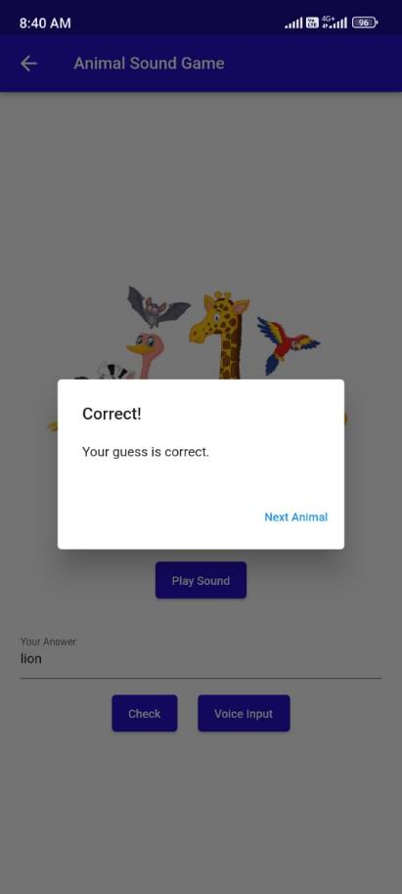
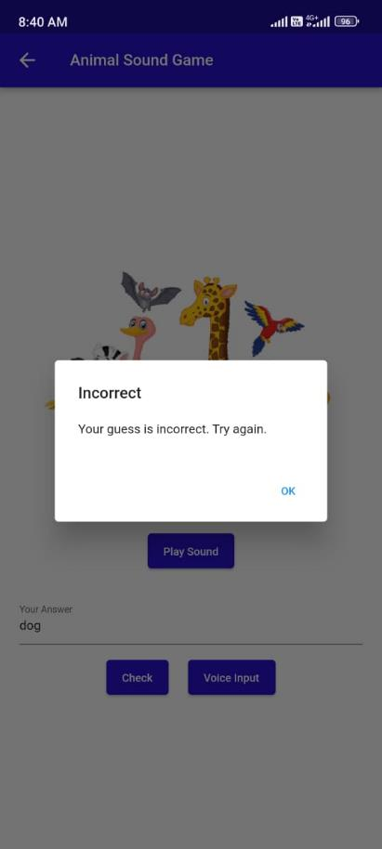

Slide 36
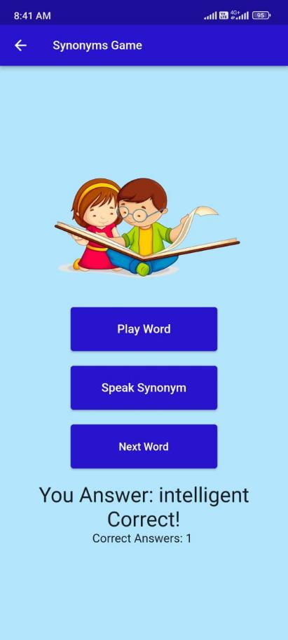


Slide 37

Future works
Update the UI s with more features.
Add Gestures
Enabled the accessibility mode in Home page

Slide 38
References
IT20146474 | Liyanage A.L.D.K.S| TMP-23-310 | Gaming Module

Slide 39
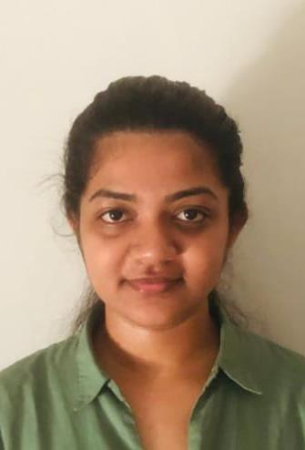
Nayanananda W.A.K.D
IT20237622
Information Technology

Slide 40
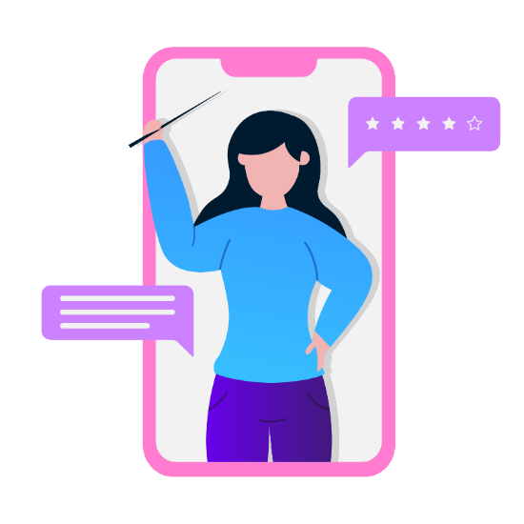
Tutor recommendation module
Students whose eyesight is good can find the tutors easily, and they can be able to identify the suitable tutor from themselves without any hesitation.
But to the visually impaired students:
The tutors who are teaching studies related to the visually impaired are very rare, and they don’t suit for all types of disabilities or their knowledge levels
The recommendation is based on:
The marks that the student gained from the online exam
The disability

Slide 41
Research Problem
How to create a platform to recommend a tutor based on learner’s knowledge and level of disability?
How to evaluate online examination platform to measure knowledge level of visual impaired students?
How to create a platform that facilitates the use of accessibility mode?
IT20237622 | Nayanananda W.A.K.D| TMP-23-310 | Tutor recommendation module

Slide 42
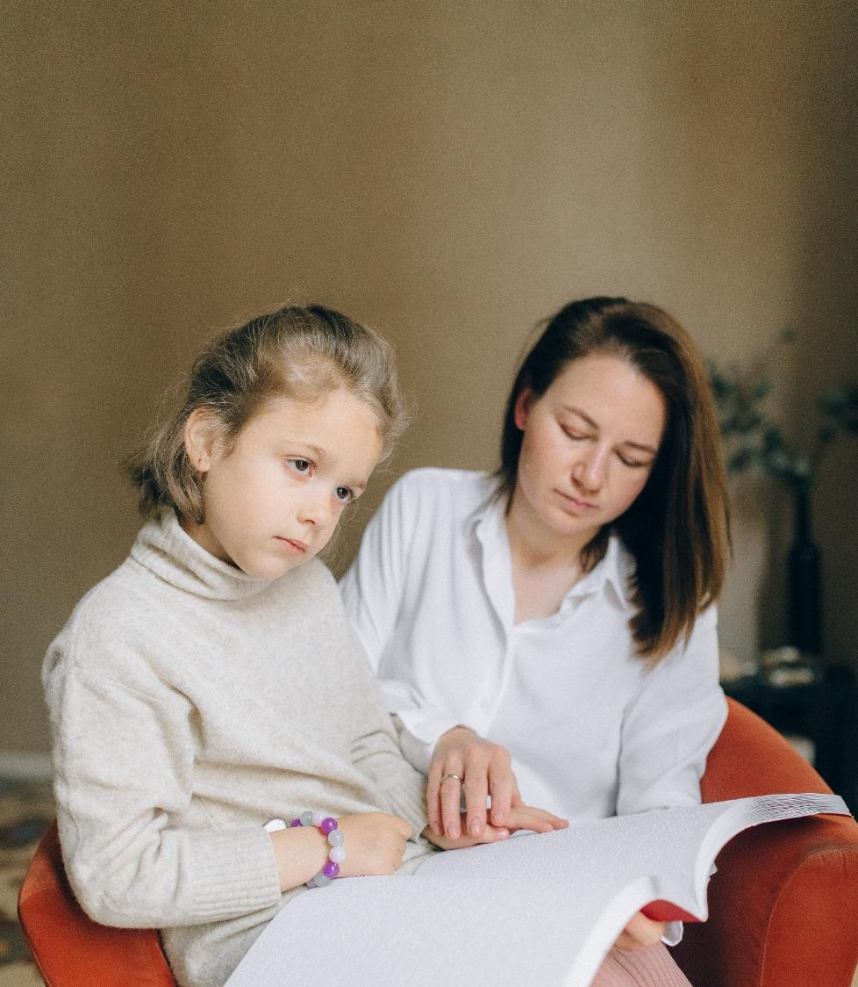
Objectives
To create a platform to recommend a tutor based on learner’s knowledge and level of disability.
To acknowledge the knowledge level of visually impaired students by holding an online voice-based examination.
To facilitate the accessibility mode for improving vision in the system.
IT20237622 | Nayanananda W.A.K.D| TMP-23-310 | Tutor recommendation module

Slide 43
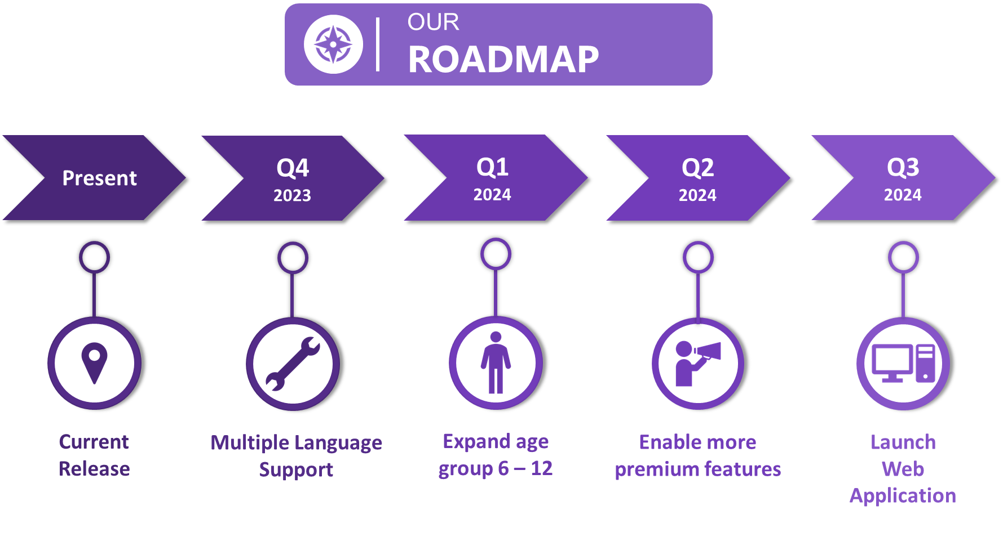

Slide 44
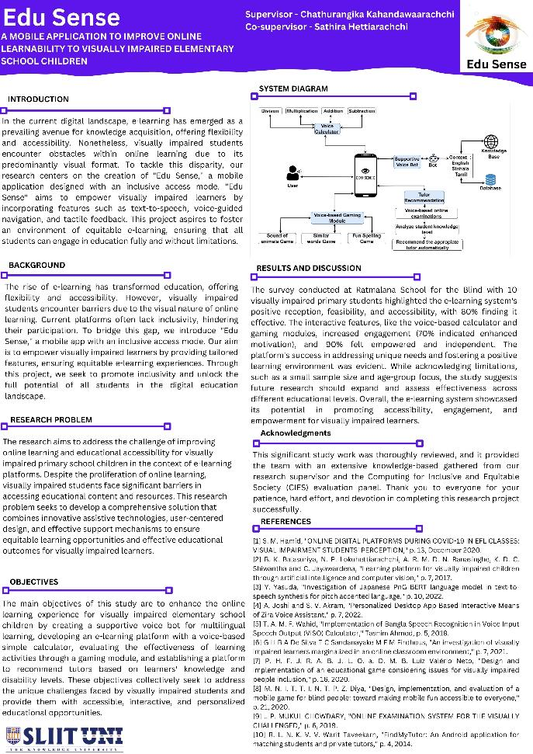
Poster Designed For
Edu Sense

Slide 45
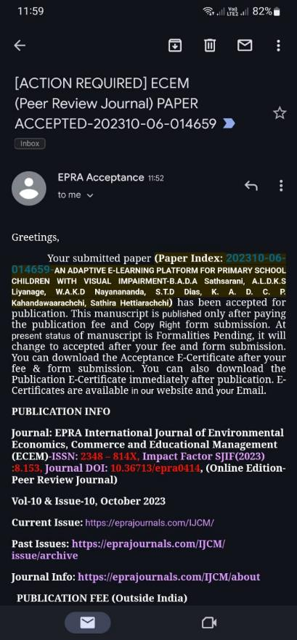
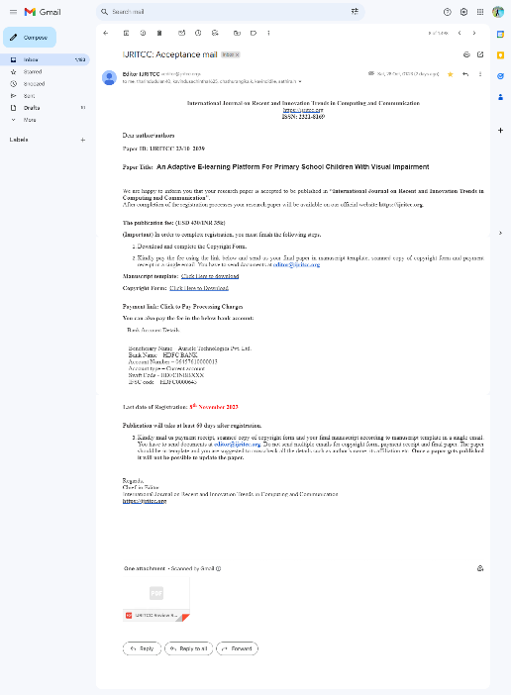
Research Paper Acceptance

Slide 46
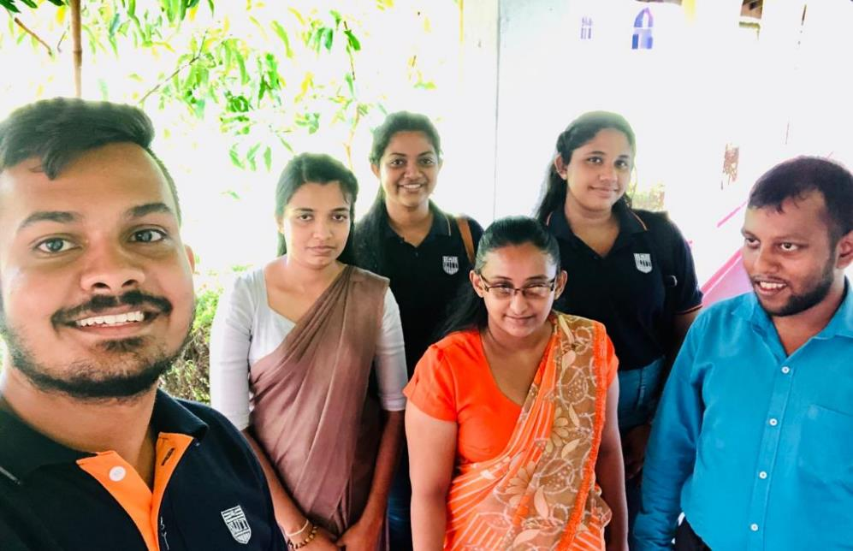
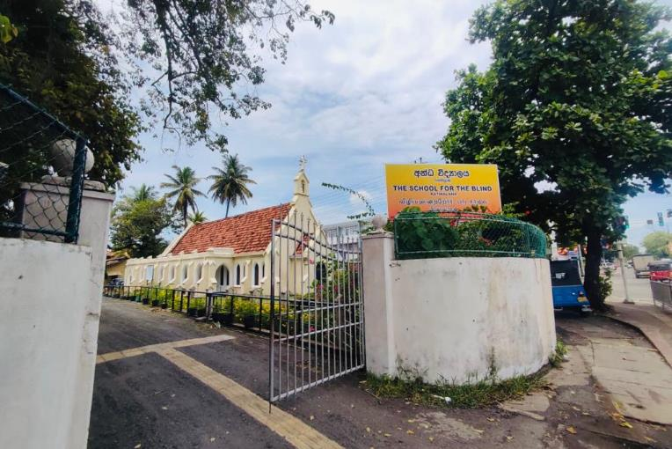
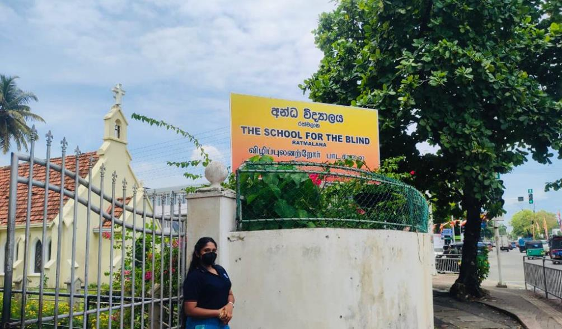
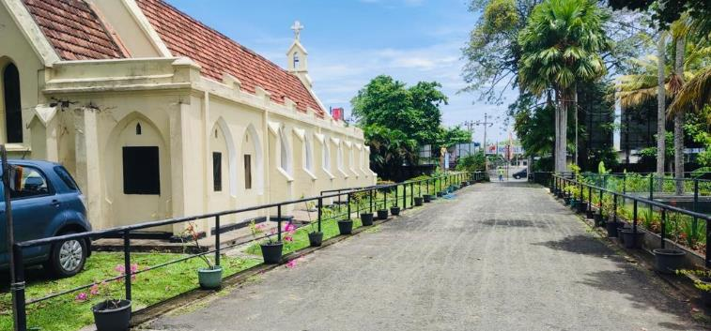
SNAPS OF DATA SURVEY

Slide 47
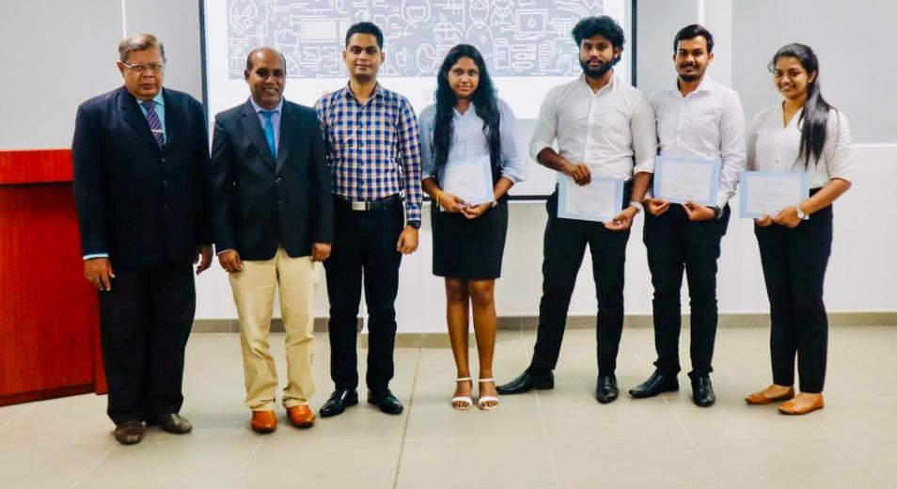
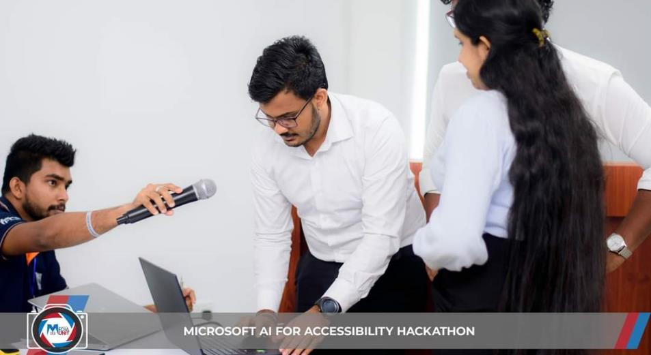
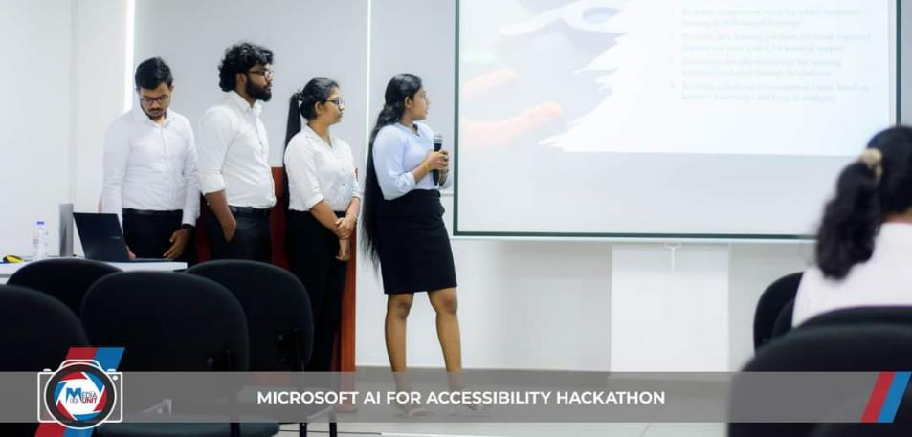
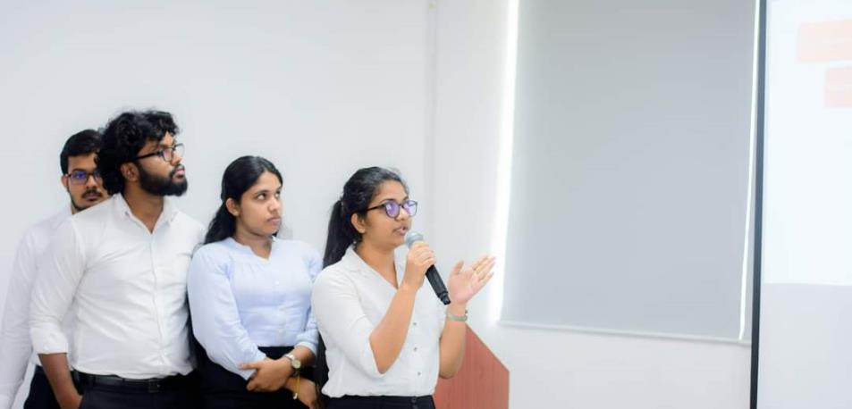
Microsoft AI for Accessibility Hackathon

Slide 48


